Slide 1
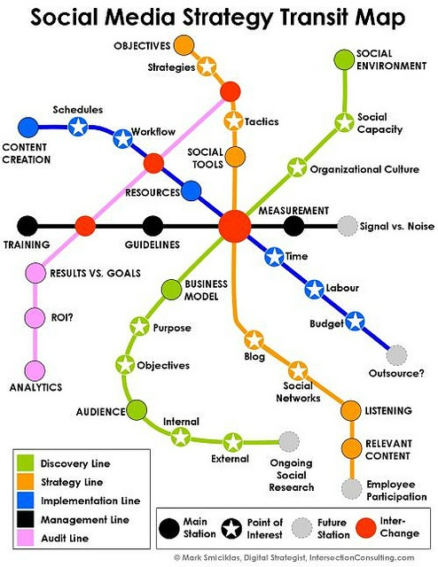
Social Media and the Enterprise, SEO
Module 8

Slide 2
Memos
Memo 6
This is an opinion memo
Still requires citations (2) (keep it current -less than 2 years old)
Recommendation is an IT Governance Plan for IT Decisions
Background/Justification section
Tell me what was valuable to you from the module on RFP, SLA and IT Governance
Yes, you may cite class materials

Slide 3
Web Assignment 5
Your Web Assignment 5 is due July 14, 5pm.
Make sure you add some posts (content) for this assignment as well. (you should already have several posts)
Make sure that all of the previous assignment components continue to work (Login, registration, widgets and plugins) when you complete Web 5
I will grade Web Assignment 4 and 5 together
D2L discussion Board
Please continue with D2L discussion board postings and commentary (1 post + 2 comments)

Slide 4
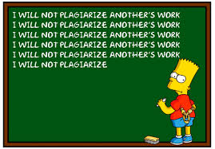
A Critical Reminder
Note that in case I see an increase in the use of material not written by the submitter without proper quotation or citation.
I do, on occasion, use turnitin
This becomes a violation of Academic Integrity Policy and subject to dismissal from the university.
If it happens, I have the right to file an Academic integrity report.

Slide 5
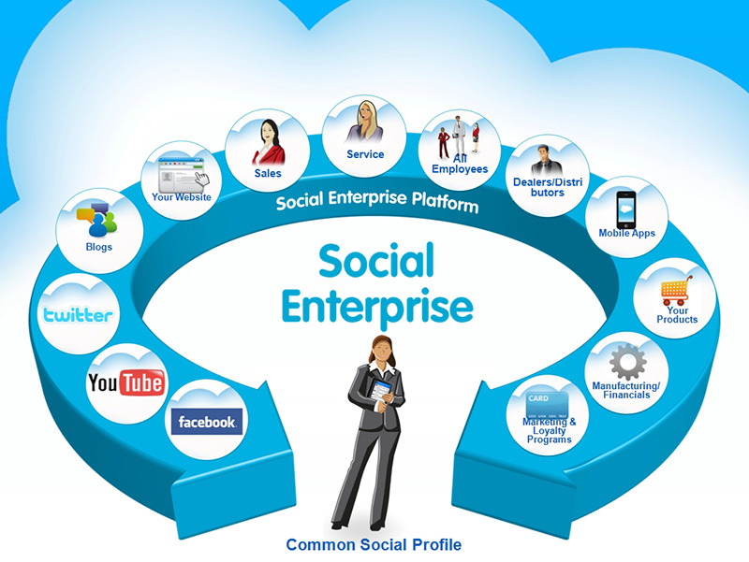
Next UP
Social Media and the Enterprise

Slide 6
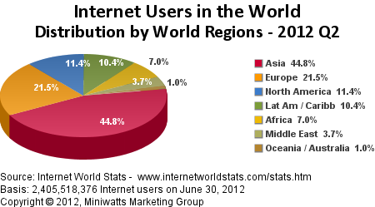
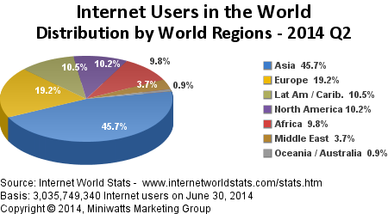

Slide 7
WORLD INTERNET USAGE AND POPULATION STATISTICS – COMPARISON BETWEEN JUNE 2012 AND JUNE 2014
World Regions | Population ( 6/2012 Est.) | Internet Users Dec. 31, 2000 | Internet Users (6/2012 Est.) | Penetration (% Population) | Growth 2000-2012 | Users % of Table
Africa | 1,073,380,925 | 4,514,400 | 167,335,676 | 15.6 % | 3,606.7 % | 7.0 %
Asia | 3,922,066,987 | 114,304,000 | 1,076,681,059 | 27.5 % | 841.9 % | 44.8 %
Europe | 820,918,446 | 105,096,093 | 518,512,109 | 63.2 % | 393.4 % | 21.5 %
Middle East | 223,608,203 | 3,284,800 | 90,000,455 | 40.2 % | 2,639.9 % | 3.7 %
North America | 348,280,154 | 108,096,800 | 273,785,413 | 78.6 % | 153.3 % | 11.4 %
Latin America / Caribbean | 593,688,638 | 18,068,919 | 254,915,745 | 42.9 % | 1,310.8 % | 10.6 %
Oceania / Australia | 35,903,569 | 7,620,480 | 24,287,919 | 67.6 % | 218.7 % | 1.0 %
WORLD TOTAL | 7,017,846,922 | 360,985,492 | 2,405,518,376 | 34.3 % | 566.4 % | 100.0 %
World Regions | Population ( 2014 Est.) | Internet Users Dec. 31, 2000 | Internet Users June 2014 | Penetration (% Population) | Growth 2000-2014 | Users % of Table
Africa | 1,125,721,038 | 4,514,400 | 297,885,898 | 26.5 % | 6,498.6 % | 9.8 %
Asia | 3,996,408,007 | 114,304,000 | 1,386,188,112 | 34.7 % | 1,112.7 % | 45.7 %
Europe | 825,824,883 | 105,096,093 | 582,441,059 | 70.5 % | 454.2 % | 19.2 %
Middle East | 231,588,580 | 3,284,800 | 111,809,510 | 48.3 % | 3,303.8 % | 3.7 %
North America | 353,860,227 | 108,096,800 | 310,322,257 | 87.7 % | 187.1 % | 10.2 %
Latin America / Caribbean | 612,279,181 | 18,068,919 | 320,312,562 | 52.3 % | 1,672.7 % | 10.5 %
Oceania / Australia | 36,724,649 | 7,620,480 | 26,789,942 | 72.9 % | 251.6 % | 0.9 %
WORLD TOTAL | 7,182,406,565 | 360,985,492 | 3,035,749,340 | 42.3 % | 741.0 % | 100.0 %

Slide 8
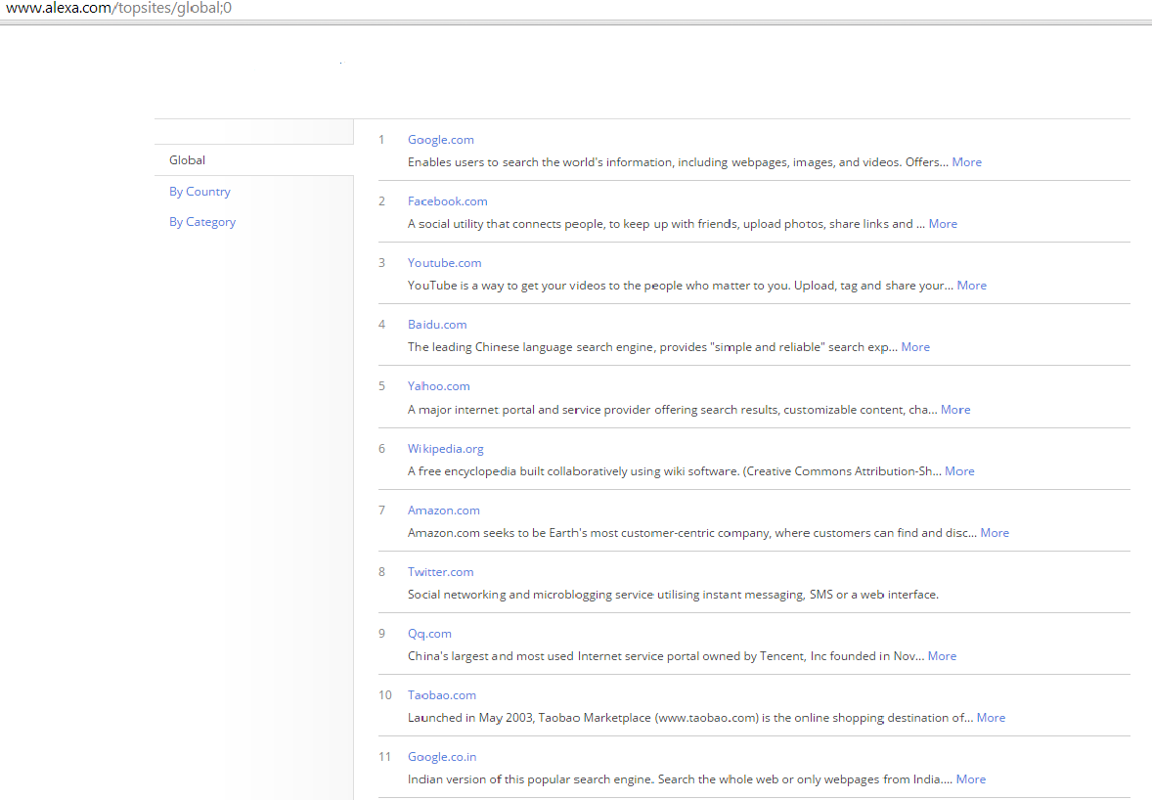
Top internet Sites
WordPress is #34

Slide 9
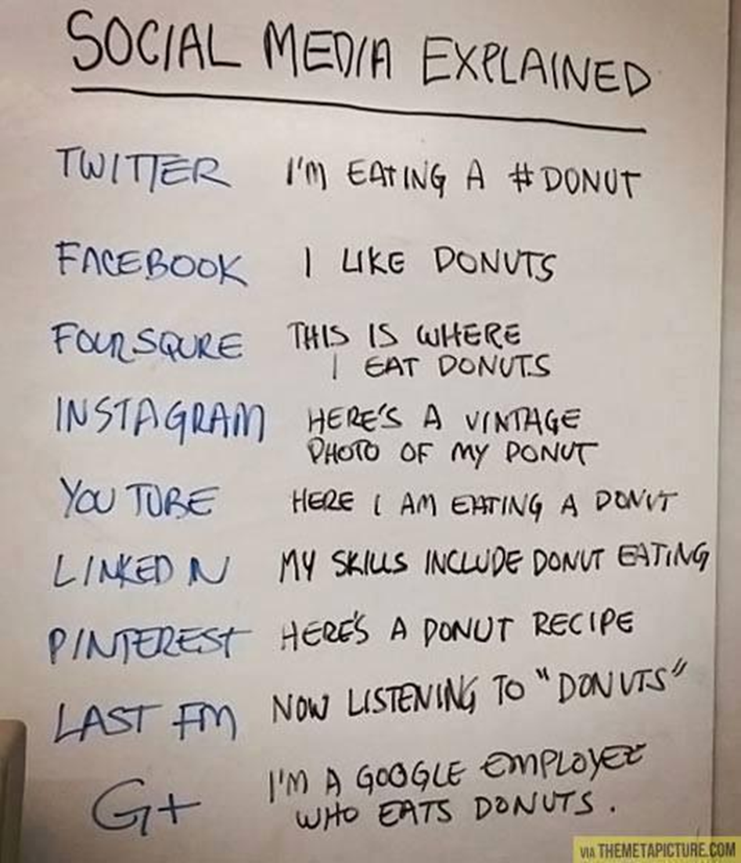

Slide 10
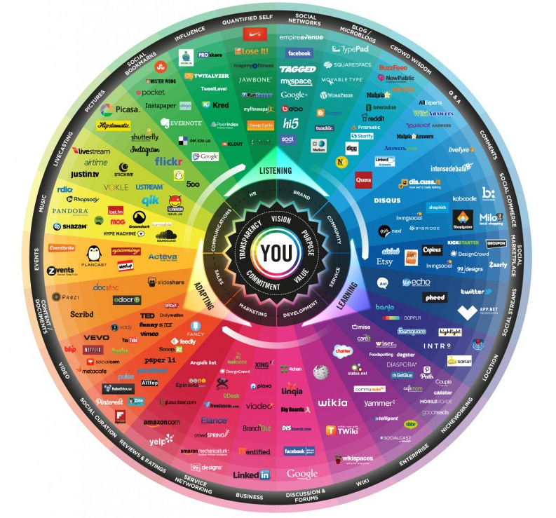
The 26 dimensions of the Conversation Prism
Notes:
Developed in 2008 by Brian Solis, The Conversation Prism is a visual map of the social media landscape. It’s an ongoing study in digital ethnography (the scientific description of the customs of individual peoples and cultures) that tracks dominant and promising social networks and organizes them by how they’re used in everyday life

Slide 11
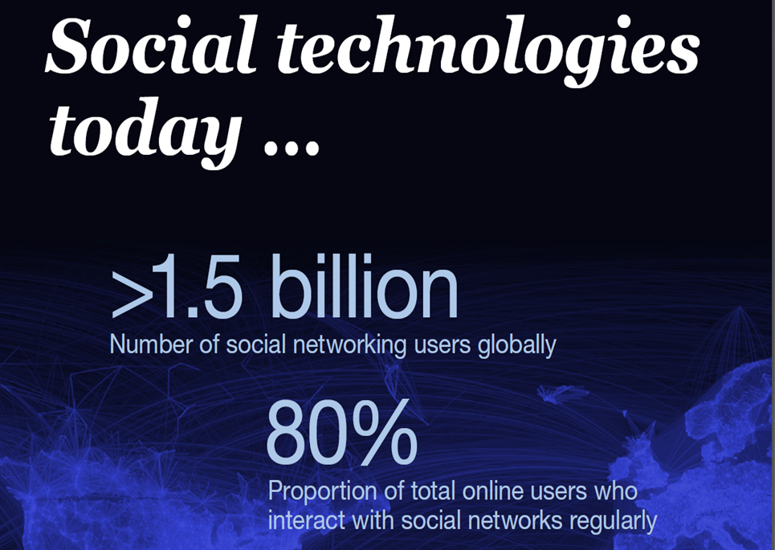
MCKINSEY GLOBAL INSTITUTE UNLOCKING VALUE AND PRODUCTIVITY THROUGH SOCIAL TECHNOLOGIES

Slide 12
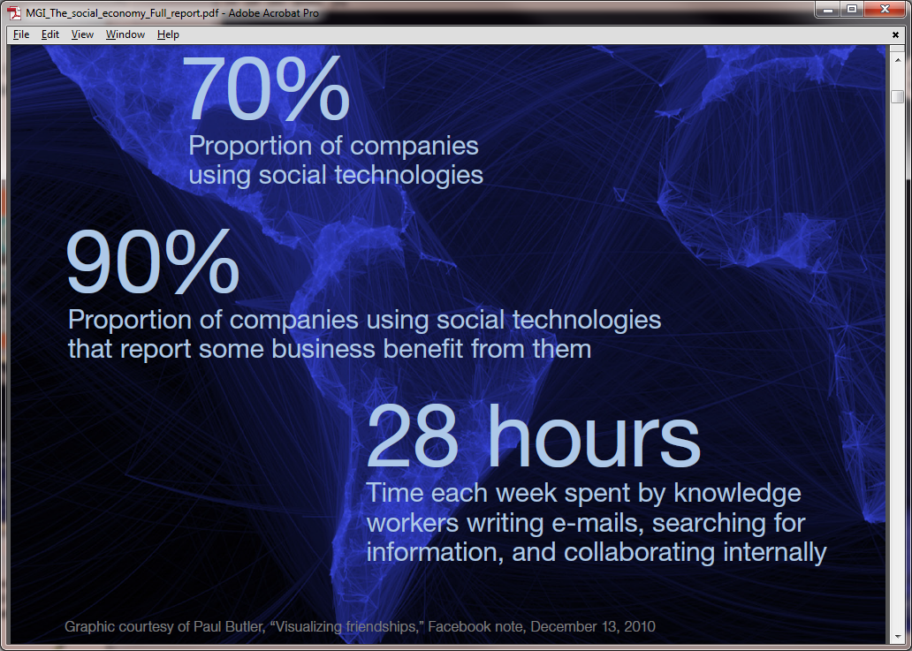

Slide 13
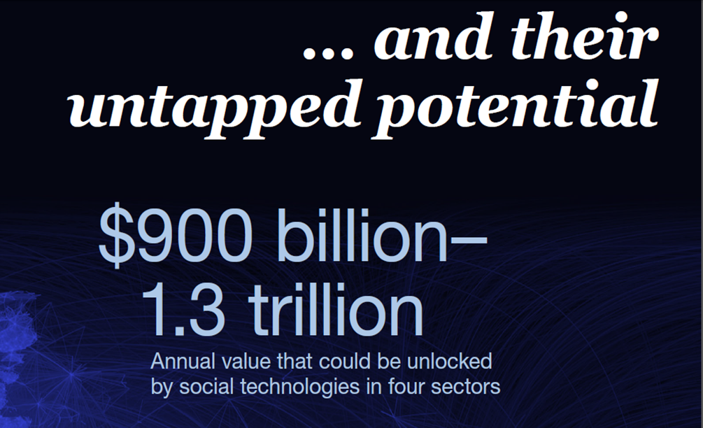
4 sectors are:
-consumer packaged goods
-retail financial services
-advanced manufacturing professional services

Slide 14
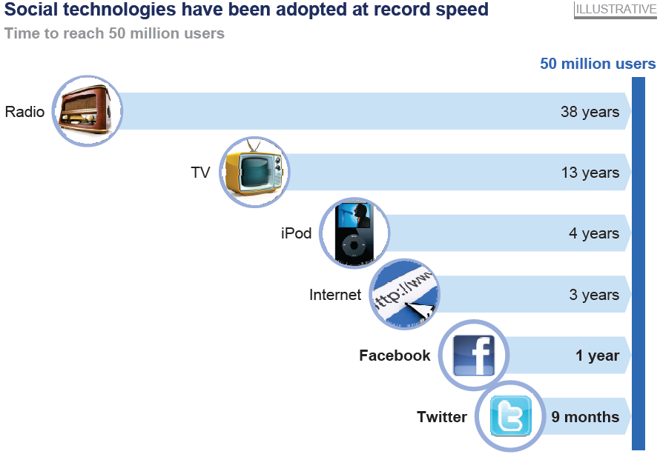

Slide 15
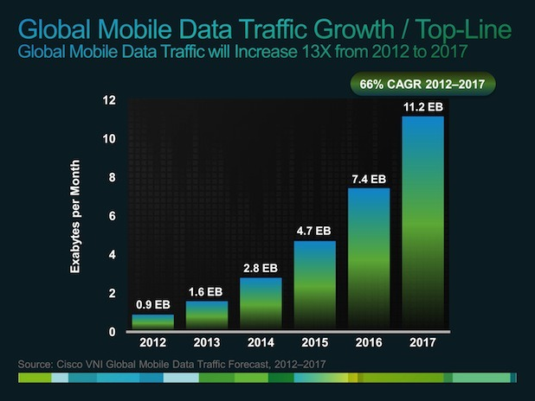

Slide 16
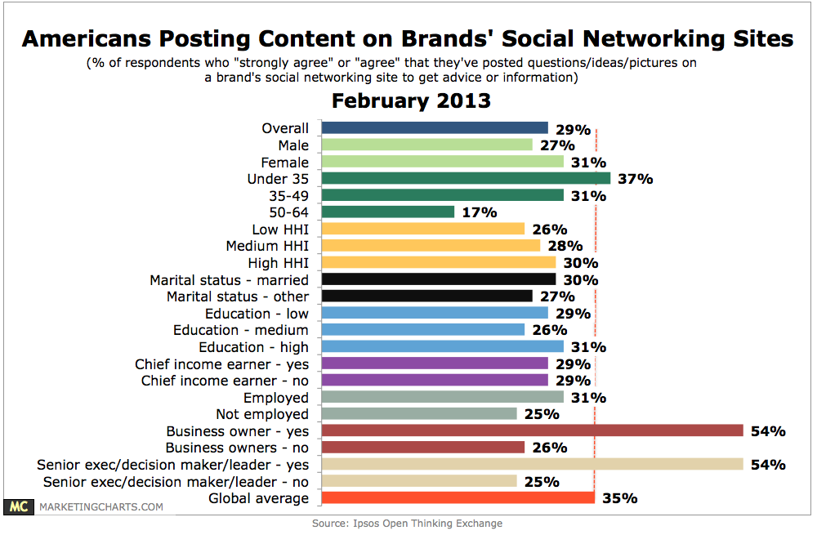
Social Media Use

Slide 17
2/3 of value creation from social technologies lies in improving communications and collaboration

Slide 18
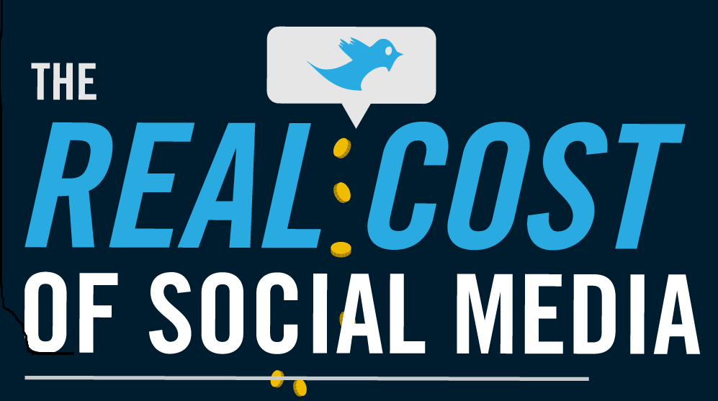
Cost of Social Media Strategy
http://digitalbuzz.s3.amazonaws.com/wp-content/uploads/2011/05/Infographic-The-Real-Cost-Of-Social-Media.png

Slide 19
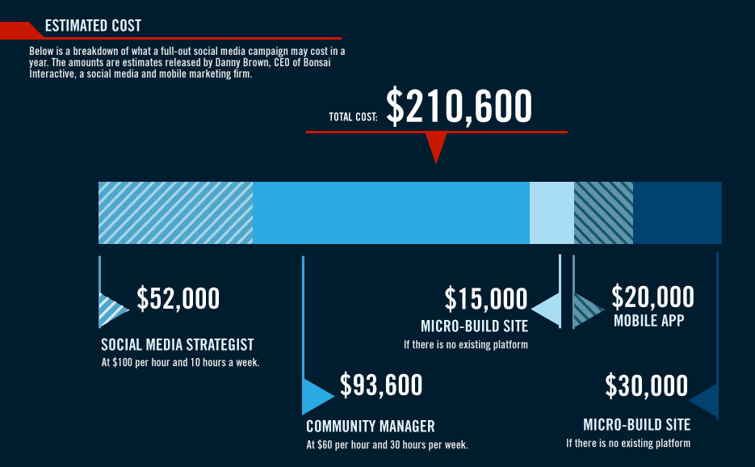
Full Campaign costs

Slide 20
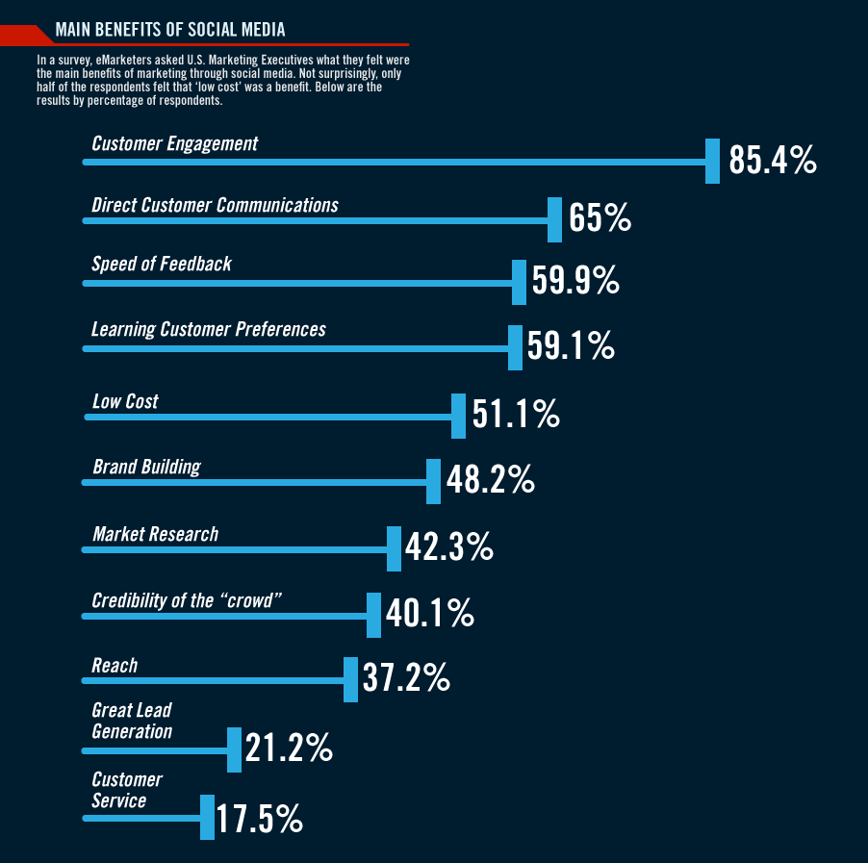
Benefits

Slide 21
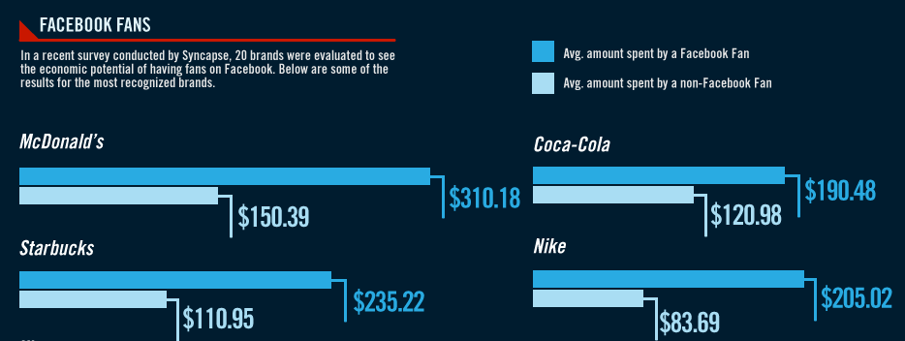
Impacts

Slide 22
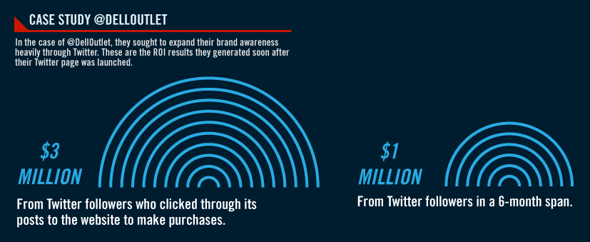
Impacts

Slide 23
Benefits of social technologies will likely outweigh the risks for most companies
Failing to invest in appropriate use of Social Technolgy will be the greater risk

Slide 24

What constitutes Social Media?
Online, user created multi-media, often with sharing and commenting about objects, w/o intermediary
Message
It is really about the message

Slide 25
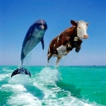
HOW ARE ENTERPRISE 2.0 AND SOCIAL MEDIA DIFFERENT?
Enterprise 2.0
Social Media
Internal facing
Knowledge capture
Productivity and efficiency
Collaborative
Examples are Wikis, blogs, social bookmarks, chat
External facing
Open to the world
Social
Examples are Social networks and “cool interactive” sites

Slide 26
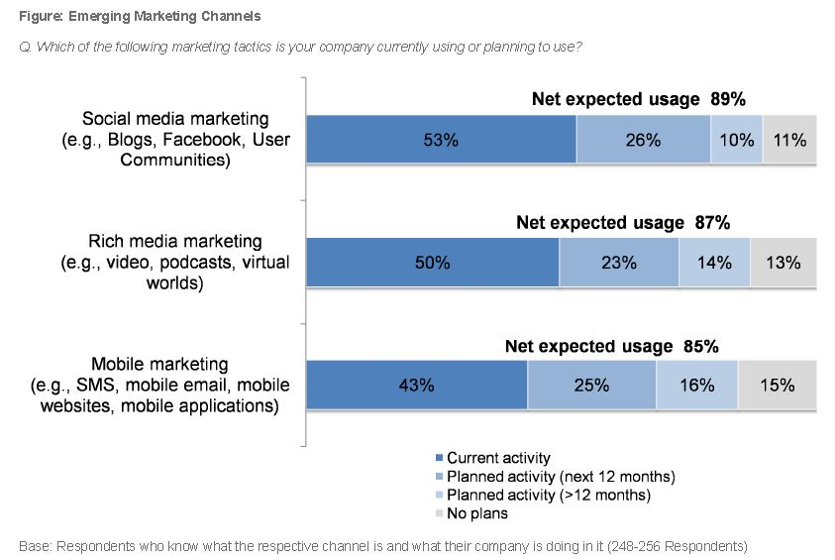
Emerging Marketing Channels

Slide 27
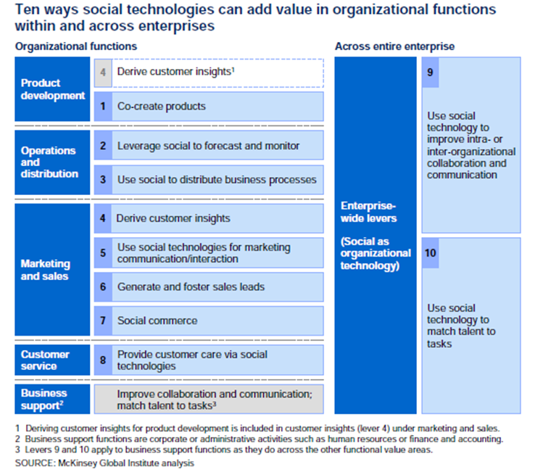

Slide 28
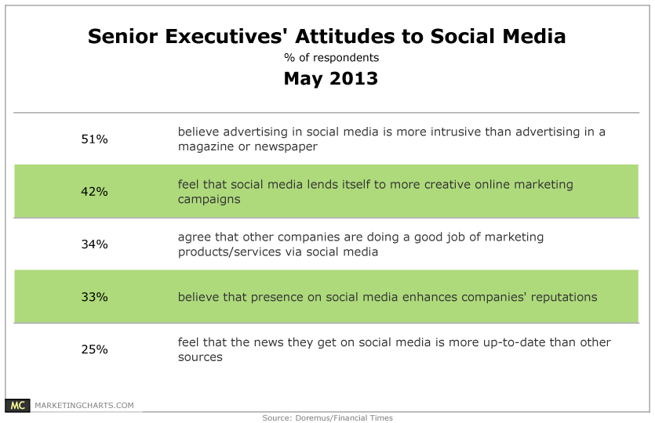
But is it Good?

Slide 29
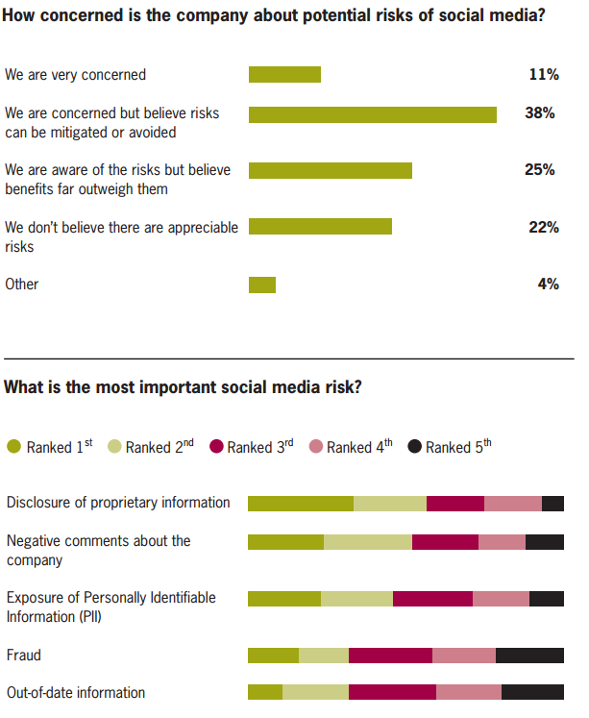

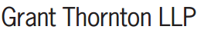
Social Media and it’s Associated Risks

Slide 30
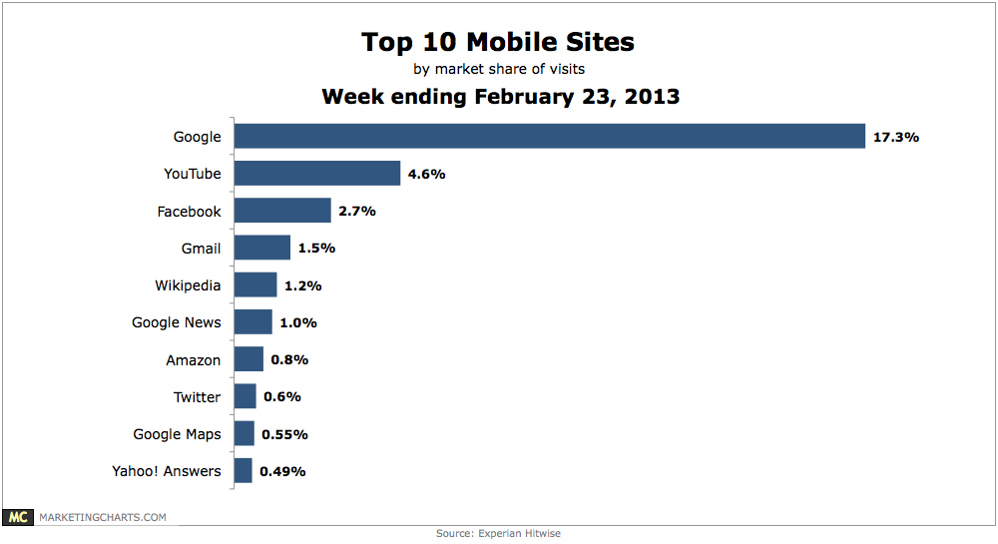
For Social Technologies Mobile is Very Important -- Almost Essential!

Slide 31
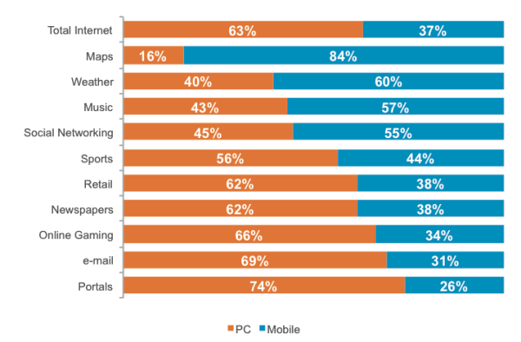
Time is UP significantly

Slide 32
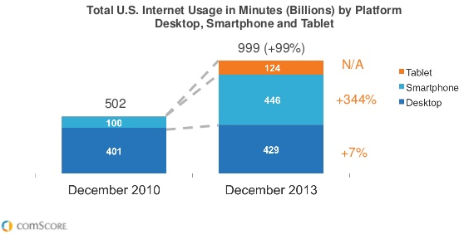
usage is UP significantly

Slide 33
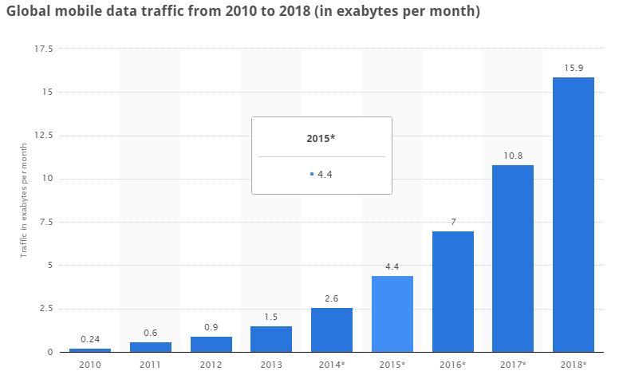
Data Traffic is UP significantly

Slide 34
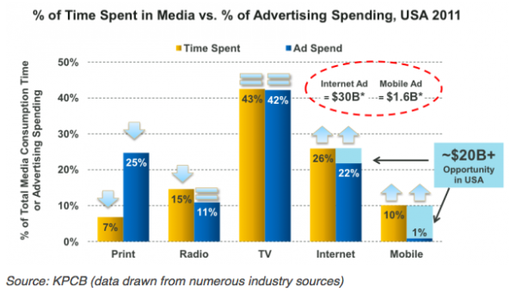
Advertising Spend is UP

Slide 35
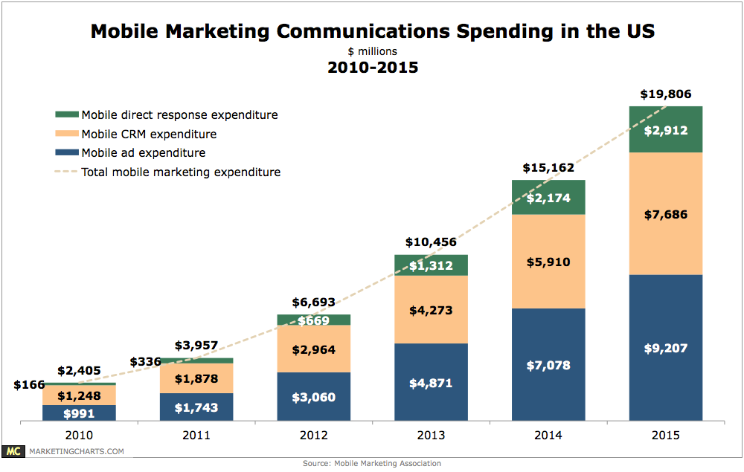
And the $$ will follow

Slide 36
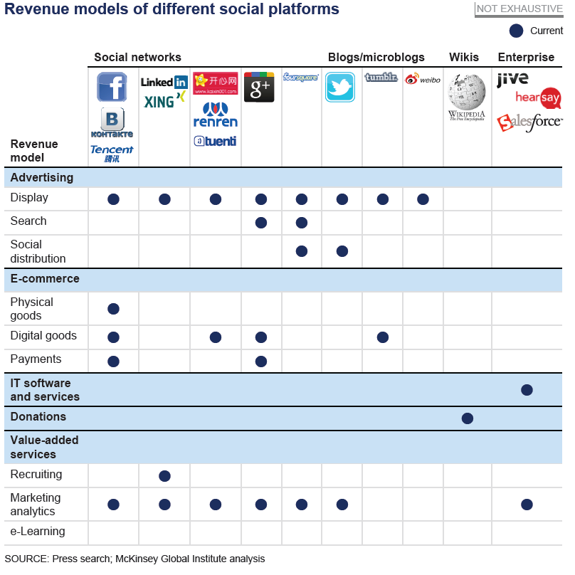

Slide 37
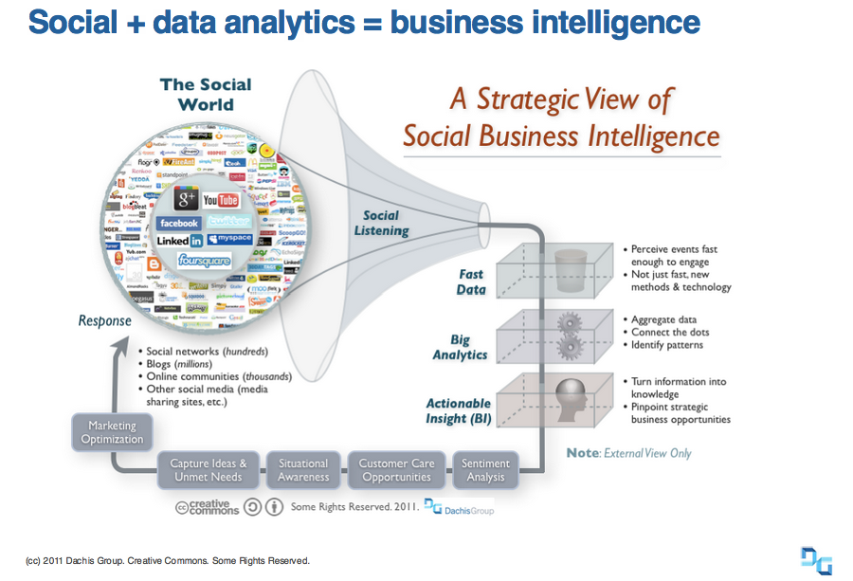
Notes:
1. Tracking the growth of social analytics and the means of delivering it.
2. Connecting analytics to the needs of the business is the next step beyond basics of collating, aggregating, and identifying patterns in what the world is doing that affects your organization.
3. Nowadays Big data represents a set of highly innovative new ways that companies are developing to distill value from the sheer scale, richness, and complexity of today’s vast networks of people and their data, of which the Internet is just the biggest example.
4. It is social media in particular, however, where big data and business value intersect.

Slide 38
Developing a SM Strategy – Discussion
What do you think TRU could do with Social Media (outward facing)?
In small groups come up business objectives that could be met with Social Media
Then develop a list of Social Media Technologies that could be used to help meet each objective.

Slide 39
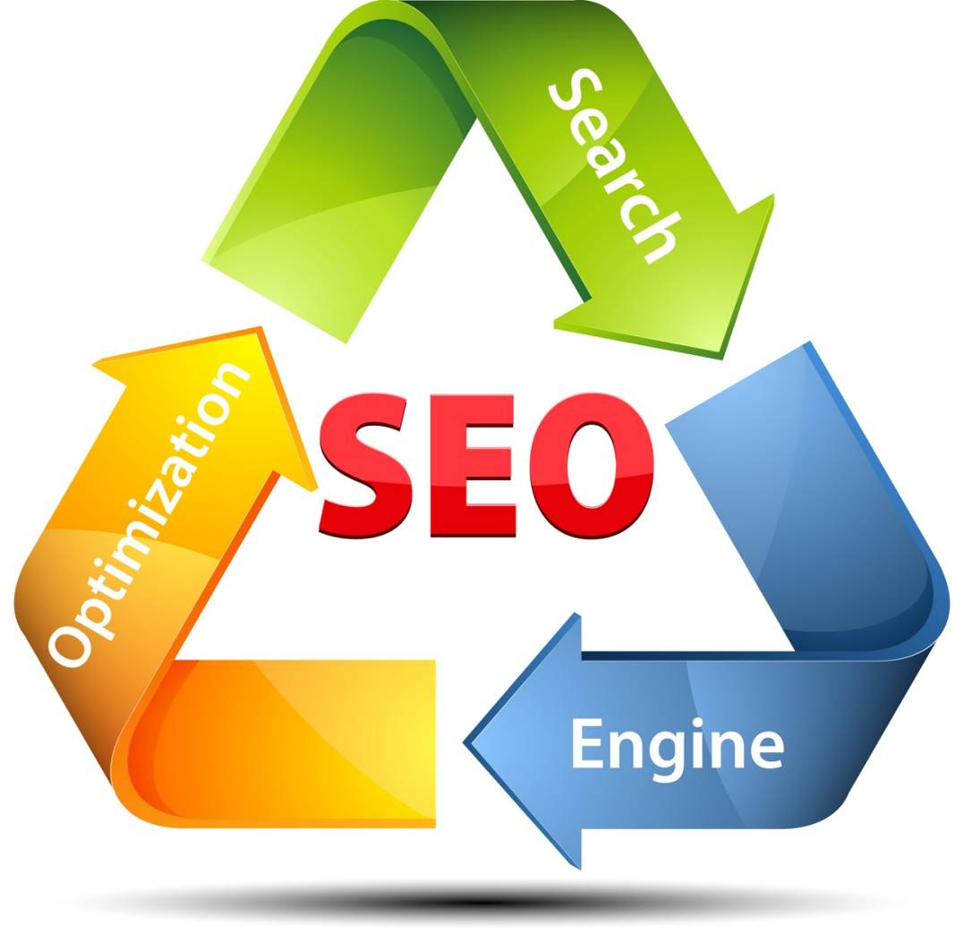
Next Topic
Search Engine Optimization

Slide 40
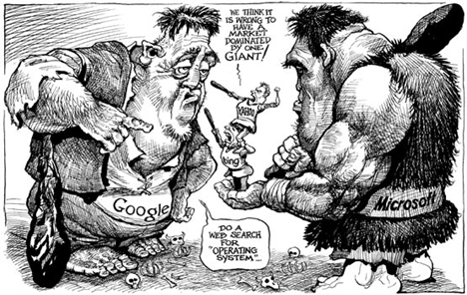
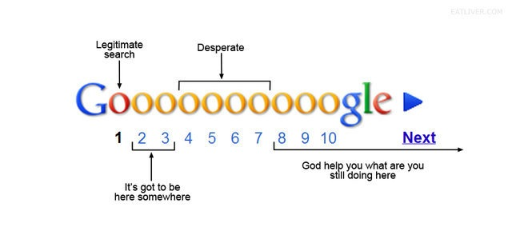
Search Engine Optimization (SEO)

Slide 41
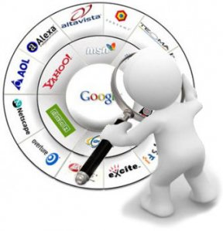
What is a Search Engine
Definition: An internet based tool that searches an index of documents for a particular term, phrase or text specified by the user. Commonly used to refer to large web-based search engines that search through billions of pages on the internet.
A search engine is a web-based tool that enables users to locate information on the World Wide Web.
Different than a directory

Slide 42
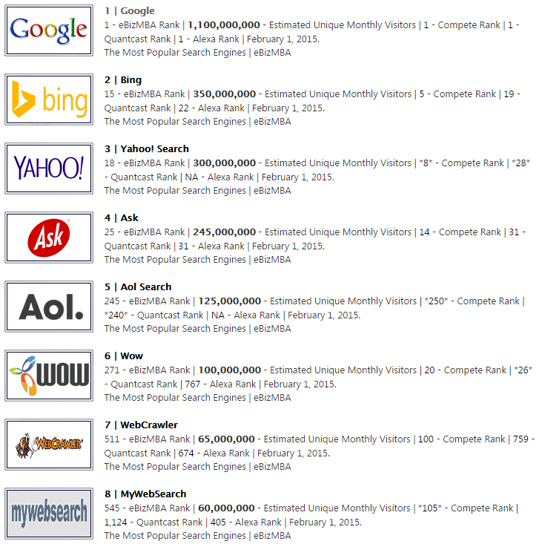
Top eight Search Engines (US)

Slide 43
Search Engines
Common Characteristics:
Spider, indexer, Database, Algorithm
Find matching documents and display them according to relevance
Frequent updates to documents searched and ranking algorithm
Strive to produce “better”, more relevant results than competitors

Slide 44
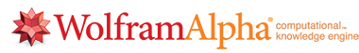









Examples of popular Search Engines

Slide 45
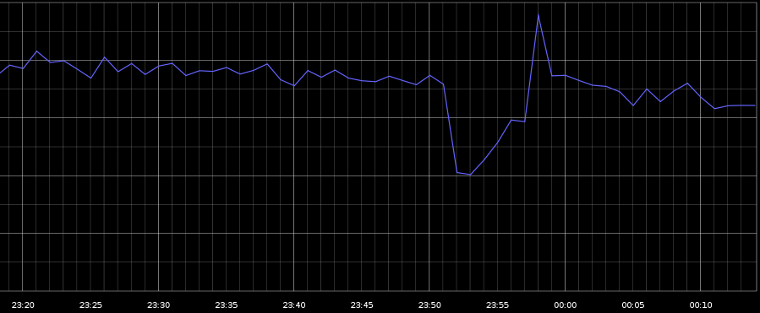
When Google Goes Dark
In August 2013, Google went offline for 1-5 min,
40% drop in World-wide Internet traffic !
GoSquared.com

Slide 46
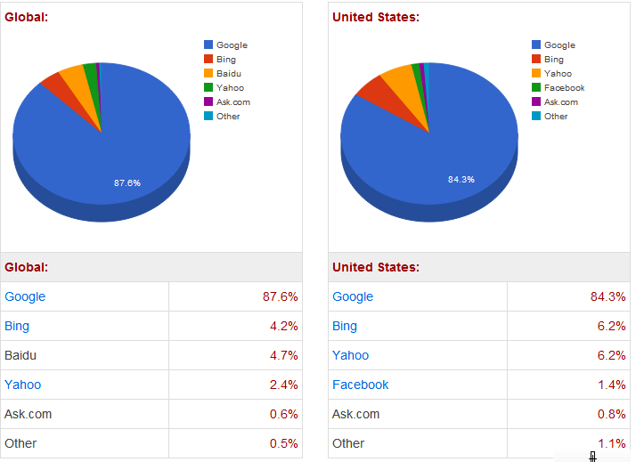
SE Market Share

Slide 47
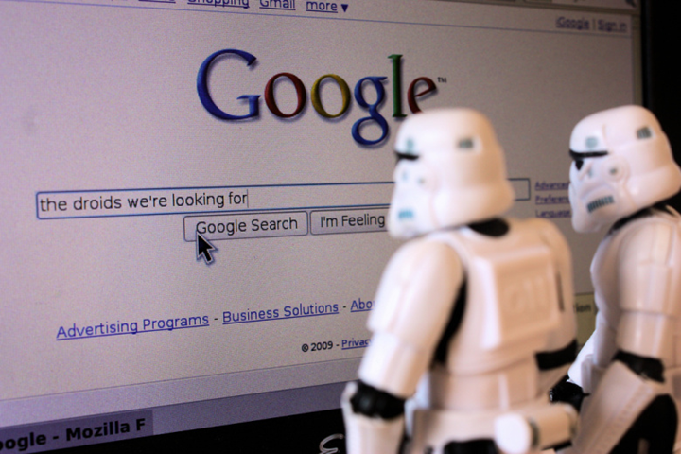
Searching 30 Trillion pages, 100 Billion times per month
A web crawler/web spider/web robot crawls the web to find new documents (web pages, other documents) typically by following hyperlinks from websites already in their database
Search engines index the content (text, code) in these documents by adding it to their databases and then periodically update it
Notes:
A Web crawler is an Internet bot that systematically browses the World Wide Web, typically for the purpose of Web indexing.
It is a program or automated script which browses the World Wide Web

Slide 48
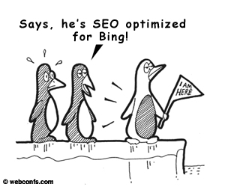
SEO at Work
Search engines search their own databases when a user enters a search to find related documents (not searching web pages in real-time)
Search engines rank the resulting documents using an algorithm (mathematical formula) by assigning various weights and ranking factors

Slide 49
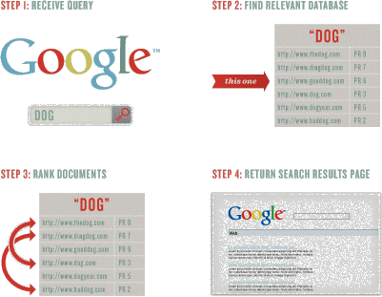
Keyword Usage

Slide 50
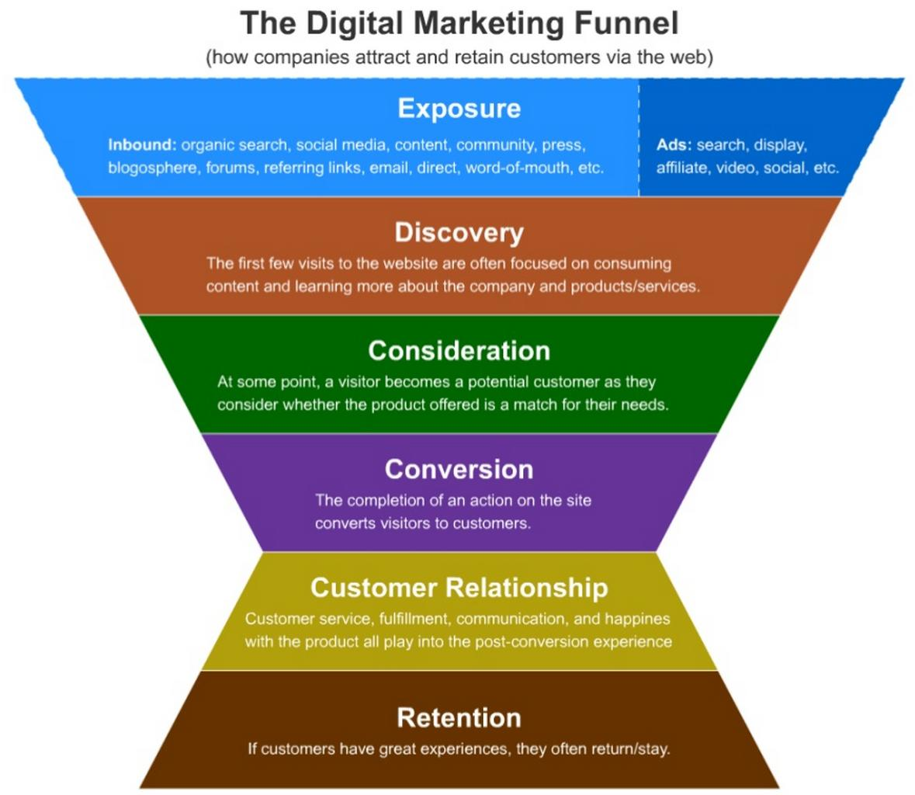

Slide 51
What is SEO
Refers to the process of “optimizing” both the on-page and off-page ranking factors in order to achieve high search engine ranking for targeted search terms.
Refers to “industry” that has been created around using keyword searching as a means of increasing relevant traffic to a website

Slide 52
Why is SEO important?
85% of all traffic on the internet is referred by search engines
90% of all users don’t look past the first 30 results (most only view the top 10)
Search engine traffic is low and websites aren’t indexed because they are generally poorly optimized
Cost-effective advertising
Clear and measurable ROI
Operates under assumption:
More (relevant) traffic + Good Conversion Rate = More Sales/Leads

Slide 53
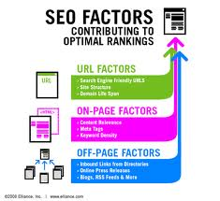
ON Page Ranking Factors
May require changes to the HTML source code of a site.
SEO tactics may be incorporated into web site development an design.
Search Engine “friendly “
used to describe web site designs, menus, content management systems, images, videos shopping carts, and other elements that have been optimized for the purpose of SE exposure

Slide 54
Off-Page Ranking Factors
Off-page optimization are strategies for SEO that are done off the pages of a website to maximize its performance in the search engines for target keywords related to page content.
Examples of off-page optimization include linking, and placing keywords within anchor text (clickable text in a web page). Methods of obtaining links can also be considered off-page optimization:
Press releases, SN (digg, twitter, fb, slashdot), directory listings, blogs, forums, internet marketing

Slide 55
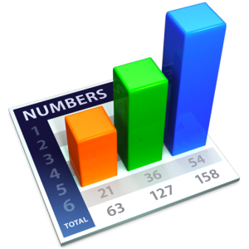
Ranking Factors
On-page
Title tags <title> #2
Header tags <h1> #5
ALT image tags #4
Content is KING <body> #1
Hyperlink text #6
Keyword frequency and density #3
Off-page
Link popularity (“votes” for your site) -- #2
Anchor text #1

Slide 56
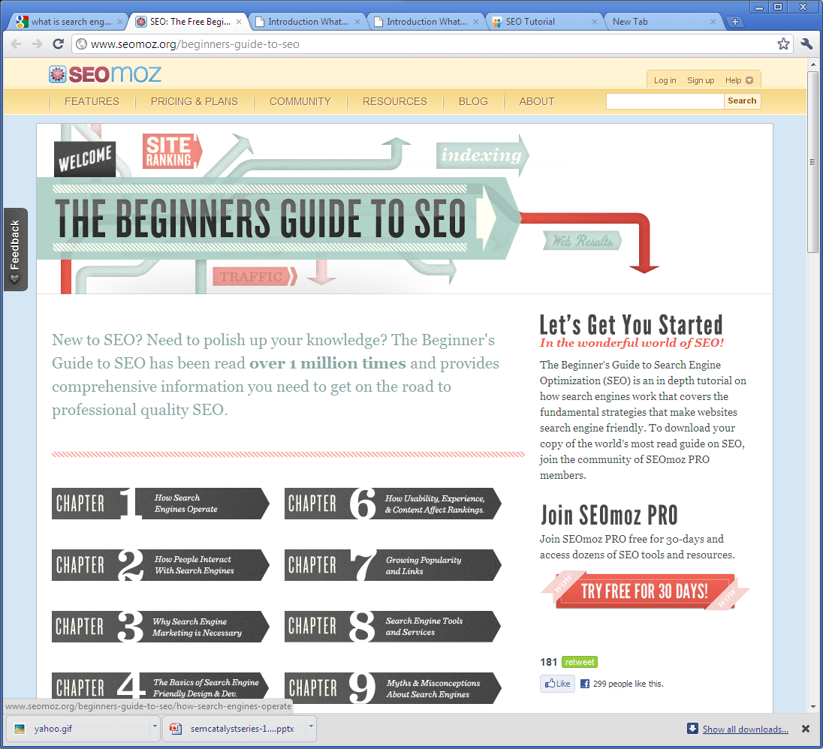
Page Title
Navigation
Alt-tags
Anchor Text
http://moz.com/beginners-guide-to-seo

Slide 57
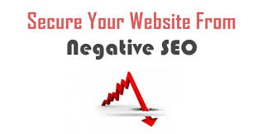

Top 5 Negative Factors in Rankings
On & Off-Page Factors:
Server is often inaccessible to spiders
Content is very similar or duplicate to existing content in the index
External links to low quality/spam sites
Duplicate title/meta tags on many pages
Participation in link schemes or actively selling links
Notes:
57

Slide 58

Organic?
Organic search results are listings on SE results pages that appear because of their relevance to the search terms, as opposed to their being advertisements.
Non-organic/Paid Search/Pay Per Click(PPC)
Is an internet advertising model used on websites in which advertisers pay their host only when their ad is clicked. With se advertisers typically bid on keyword phrases relevant to their target market. Content sites commonly charge a fixed price per click rather than use a bidding system (Google uses both)

Slide 59
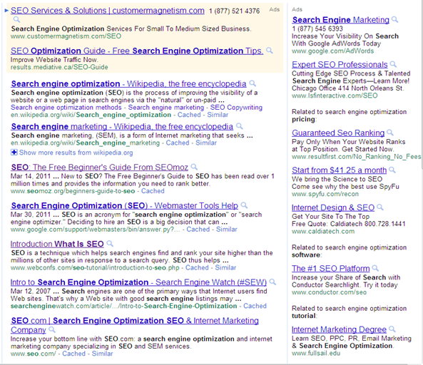
Pay Per Click
Organic
Pay Per Click

Slide 60
Who gets the clicks?
The vast majority of clicks – roughly 60 percent go to organic listings
Search Engine | % Organic Listing Click Through | % PPC Listing Click Through
Google | 72 | 28
MSN | 71 | 29
Yahoo | 61 | 39
AOL | 50 | 50
Average | 63.5 | 36.5

Slide 61
Click Through
1st Ranked page gets 42.25% of click through
2nd 11.94%
3rd 8.47%
4th 6.05 %

Slide 62


White Hat SEO
Conforms to search engine guidelines and involves no deceptions.
Generally summed as creating content for users not search engines and then making that content easily accessible to spiders, rather than attempting to game the algorithm.
Promotes accessibility

Slide 63

Black Hat SEO
Attempts to improve rankings in ways disapproved of by the search engines or involve deception.
Use hidden text, invisible div, or is positioned off screen
Can use keyword and page stuffing
Gives a different page depending on who is requesting (human or search engine)– cloaking
SE may penalize by reducing rankings or removing from the db

Slide 64


So, what is the algorithm?
Top Secret (over 200 factors)
Reverse engineering, research experiments give SEO professionals a good idea of the major factors and approximate weight assignments
It is always tweaked and updated
Varies by search engine – some give more weight to on-page factors, others to link popularity.
Note: Each year, Google changes its search algorithm around 500–600 times. While most of these changes are minor, Google occasionally rolls out a "major" algorithmic update (such as Google Panda and Google Penguin) that affects search results in significant ways.
“Google Pigeon” (major) is the name of the new search platform that Google is using as of July 2014

Slide 65



SEO Process
Know your business objectives
Keyword analysis
Match keywords and landing pages
Baseline ranking and traffic reports
On-page and off-page optimization
Implementation
Monitor and optimize

Slide 66


Crawlable Link Structures

Slide 67

On Page SEO Example
Notes:
Use the keyword in the title tag at least once, and possibly twice (or as a variation) if it makes sense and sounds good (this is subjective, but necessary). Try to keep the keyword as close to the beginning of the title tag as possible.
More detail on title tags follows later in this section.
Once in the H1 header tag of the page.
At least 3X in the body copy on the page (sometimes a few more times if there's a lot of text content). You may find additional value in adding the keyword more than 3X, but in our experience, adding more instances of a term or phrase tends to have little to no impact on rankings.
At least once in bold. You can use either the <strong> or <b> tag, as search engines consider them equivalent.
At least once in the alt attribute of an image on the page. This not only helps with web search, but also image search, which can occasionally bring valuable traffic.
Once in the URL. Additional rules for URLs and keywords are discussed later on in this section.
At least once (sometimes 2X when it makes sense) in the meta description tag. Note that the meta description tag does NOT get used by the engines for rankings, but rather helps to attract clicks by searchers from the results page (as it is the "snippet" of text used by the search engines).
Generally not in link anchor text on the page itself that points to other pages on your site or different domains (this is a bit complex - see this blog post for details).

Slide 68

Title Tags
Less than 70 characters
Keywords to the front
Leverage your brand
Readability
An Example:
<html charset="utf-8" lang="en-US">
<head>
<title>Chicago Tribune: Chicago breaking news, sports, business, entertainment, weather and traffic - Chicago Tribune</title>

Slide 69
URL Structures
Empathy (what you expect to find at your url) (http://chicagotribune.com)
Short (https://goo.gl/ or http://tinyurl.com/)
Keyword is helpful (not required)
Static ( www.mysite.org/blog?id=123 to www.mysite.org/blog/11-best-practices )
Descriptive
www.thestore.com/hardware/screwdrivers
www.thestore.com/cat33/item4326

Slide 70

Pay Per Click
PPC appear as “sponsored listings”
Companies bid the price they are willing to pay per click
Typically they have good tracking tools and statistics
Ability to control ad text
Can set budgets and spending limits
Google AdWords and Overture (Yahoo) are 2
*If you ever get a chance to use Google Ad words- I highly recommend. I think it’s MKT595 at DePaul

Slide 71
PPC vs Organic SEO
Pay per Click | Organic SEO
Resulting in 1-2 days Easier for novice with little SEO knowledge Ability to turn on/off More costly per visitor and conversion Fewer impressions and exposure Easier to compete in market place Generate exposure on related sites Target local markets Better for short-term and high margin campaigns | Results take 3-9 months Requires ongoing learning and experience Very difficult to control flow of traffic Generally more cost effective, does not penalize for more traffic Difficult to compete in marketplace Ability to generate exposure on related sites and directories More difficult to target local markets Better for long term and lower margin campaigns

Slide 72
Measuring Success IN SEO
Keyword ranking
Website Traffic
Increase in share of traffic per keyword
Increased revenue/keyword
Lower dependence on paid search
Lowering the cost per acquisition

Slide 73







SEO Toolbox

Slide 74
SEO TIPS (GOOGLE)
Google Authorship (rich snippets)
Often people write about the debate surrounding this tag – is it or is it not helping with rankings? What is often missed is the very basic concept that an image by your result in the search engine increases your click-through rates.
Don't add this tag everywhere. Make sure it is only on well written, good content, but add it. Give your site that extra lift.
Citations
Make sure wherever you list the name of your business online that everything in each one is the same as the other. Meaning the name, phone number, contact, address, etc. between all listings is the same (not similar)

Slide 75
SEO TIPS (GOOGLE)
Content
Google likes specific content, so keep topics clear and on point. Also make sure on average your content is over 600 words per page or you risk it being penalized as thin.
URLs
Make sure your site URLs are absolute and not relative in your code. They shouldn't be too long and contain multiple query parameters.
The Alt Attribute
Use this tag properly, but use it. It belongs on every image on your site (sometimes it will be empty).
In the case of linking an image, the alt attribute acts as though you added anchor text on a page.
Remember this is a tag for the blind. Treat it with respect.

Slide 76
SEO TIPS (GOOGLE)
Page Speed
Check your site on the Google Page Speed tool. https://developers.google.com/speed/pagespeed/
Speed matters especially in mobile.
Get your site score above an 85-90.
Robots.txt
Your robots.txt doesn't block your web page from being indexed, only crawled. If you want to block a page from being indexed, leave it off the robots.txt and add a noindex tag.
To learn how to use it visit: http://www.robotstxt.org/

Slide 77
SEO TIPS (GOOGLE)
Penalties
If you try to recover your site and you fail the first time, get an expert to help you. Google penalties are tricky subjects. You may not know enough about penalty recovery to get your site out of penalty status.
The longer your site stays penalized, the harder it will be to recover your site. A site auditor will know what to look for and how to communicate with Google in order to get the best outcome.
New Sites
There is only one way to really make sure Google won't find your new site: lock it down with a login. Robots.txt don't prevent site indexing and Google doesn't need a link to find you. If you don't lock it down, don't be surprised when your new site is indexed before you wanted.
Get a Site Audit Every Year

Slide 78

SEO Myths
Myth 1: If You Build it, They Will Come
No.
If it were that easy, all SEO professionals would be writers or out of work. Unfortunately, while great writing and great content is a large part of SEO and something your site definitely needs, it also needs links, a strong technical base, fast page downloads, and the list goes on and on.
Myth 2: Link Building is Dead
Links are not dead. You need links.
example, let's say you sponsor a charity event every year, making sure to tie that in with local news, press coverage, and maybe the charity's own news release. All tied back to your site.
Myth 3: Using Google Analytics Lets Google Spy On You
Analytics is a must-have. Yet so often we hear that a client isn't putting Google Analytics on their site because Google spies on them, so they fly blind.
Not always

Slide 79
SEO MYTHS
Myth 4: Ranking (Positioning) Doesn't Matter
You've probably heard this before: "We don't care about ranking. Traffic is what we measure." While there is truth in this, it's also a bit deceptive.
converting traffic is the most important metric when measuring the ROI of you investment dollars, the difference between 1st and 5th and 5th and 10thgreatly affects the flow and amount of that traffic
Myth 5: Social is the New Link Building
No. Can you get links from social, yes, once they leave the walled garden, but not from sharing itself (Google+ excluded here).
Social is not the new link building; link building is the new link building,

Slide 80
SEO Stats
Americans performed 19.4 Billion searches in March 2014
Google did 13.1 Billion of those (~67.5% US mkt)
MS 3.6 Billion (18.6%)
Yahoo 2. Billion
Ask 478 Million
AOL 259 Million
Global – Google 100 Billion searches /month (83%)
https://www.comscore.com/Insights/Press_Releases/2014/4/comScore_Releases_March_2014_U.S._Search_Engine_Rankings

Slide 81
Interesting facts
76 % of respondents use SE to find local businesses
57% use Internet Yellow Pages
23% used Online Social Networks to find businesses
Google does 87.1% of US Mobile search
80% look online and make a purchase in person

Slide 82

Mobile Impact
Yelp says 35% of all its searches are done on mobile devices (about 690 million/day )
64% of smartphone (44% tablet) make a purchase within the hour for restaurant category searches (85% eventually converted)
Food/Restaurant
Cars/Automobile/Truck
Travel

Slide 83

How Search works

